Slide 1
UNIT-II Introduction to Solar Cells:
P-N Junction Under illumination: solar cell – generation of photo voltage – light generated current – I-V equation of solar cell – solar cell characteristics. Upper limits of cell parameters – short circuit current – open circuit voltage - Fill factor - efficiency –losses in solar cells – model of solar cell – effect of series –shunt Resistance on efficiency
– effect solar radiation on efficiency -effect of temperature on efficiency – basic design aspects of solar cells.

Slide 2
2.1 P-N Junction Under illumination:
When a photon hits a piece of silicon, one of three things can happen:
The photon can pass straight through the (generally) happens for lower energy photons.
The photon can reflect off the surface.
silicon — this
3. The photon can be absorbed by the silicon if the photon energy is higher than the silicon band gap value. This generates an electron-hole pair and sometimes heat depending on the band structure.

Slide 3
When a photon is absorbed, its energy is given to an electron in the crystal lattice. Usually this electron is in the valence band. The energy given to the electron by the photon "excites" it into the conduction band where it is free to move around within the semiconductor. The network of covalent bonds that the electron was previously a part of now has one fewer electron. This is known as a hole. The presence of a missing covalent bond allows the bonded electrons of neighbouring atoms to move into the "hole" leaving another hole behind, thus propagating holes throughout the lattice. It can be said that photons absorbed in the semiconductor create electron-hole pairs.

Slide 4
A photon only needs to have energy greater than that of the band gap in order to excite an electron from the valence band into the conduction band. However, the solar frequency spectrum approximates a black body spectrum at about 5,800 K, and as such, much of the solar radiation reaching the Earth is composed of photons with energies greater than the band gap of silicon. These higher energy photons will be absorbed by the solar cell, but the difference in energy between these photons and the silicon band gap is converted into heat (via lattice vibrations — called phonons) rather than into usable electrical energy. The photovoltaic effect can also occur when two photons are absorbed simultaneously in a process called two-photon photovoltaic effect. However, high optical intensities are required for this nonlinear process.

Slide 5
2.2 solar cell
2.2.1 generation of photo voltage
The collection of light-generated carriers does not by itself give
rise to power generation. In order to generate power, a voltage must be generated as well as a current. Voltage is generated in a solar cell by a process known as the "photovoltaic effect". The collection of light-generated carriers by the p-n junction causes a movement of electrons to the n-type side and holes to the p-type side of the junction. Under short circuit conditions, there is no build up of charge, as the carriers exit the device as light- generated current.

Slide 6
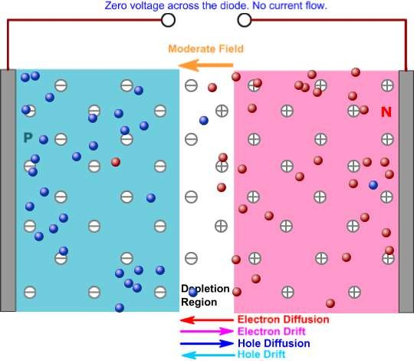

Slide 7
However, if the light-generated carriers are prevented from leaving the solar cell, then the collection of light-generated carriers causes an increase in the number of electrons on the n-type side of the p-n junction and a similar increase in holes in the p-type material. This separation of charge creates an electric field at the junction which is in opposition to that already existing at the junction, thereby reducing the net electric field. Since the electric field represents a barrier to the flow of the forward bias diffusion current, the reduction of the electric field increases the diffusion current. A new equilibrium is reached in which a voltage exists across the p-n junction. The current from the solar cell is the difference between IL and the forward bias current. Under open circuit conditions, the forward bias of the junction increases to a point where the light-generated current is exactly balanced by the forward bias diffusion current, and the net current is zero. The voltage required to cause these two currents to balance is called the "open-circuit voltage".

Slide 8
2.2.2 light generated current
The generation of current in a solar cell, known as the "light- generated current", involves two key processes. The first process is the absorption of incident photons to create electron-hole pairs. Electron-hole pairs will be generated in the solar cell provided that the incident photon has an energy greater than that of the band gap. However, electrons (in the p-type material), and holes (in the n-type material) are meta-stable and will only exist, on average, for a length of time equal to the minority carrier lifetime before they recombine. If the carrier recombines, then the light-generated electron-hole pair is lost and no current or power can be generated.

Slide 9
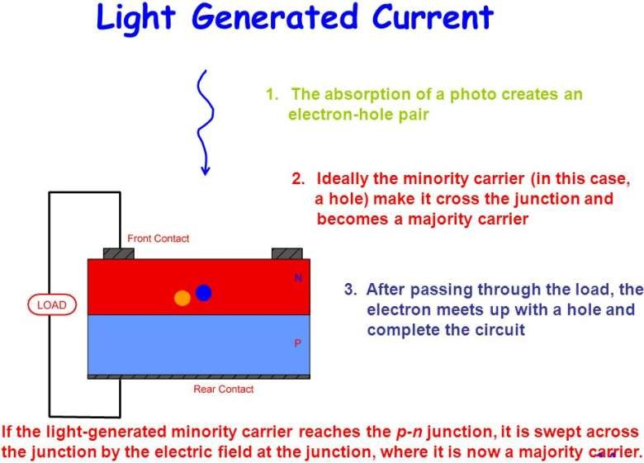

Slide 10
A second process, the collection of these carriers by the p- n junction, prevents this recombination by using a p- n junction to spatially separate the electron and the hole. The carriers are separated by the action of the electric field existing at the p-n junction. If the light-generated minority carrier reaches the p-n junction, it is swept across the junction by the electric field at the junction, where it is now a majority carrier. If the emitter and base of the solar cell are connected together (i.e., if the solar cell is short- circuited), the light-generated carriers flow through the external circuit.

Slide 11

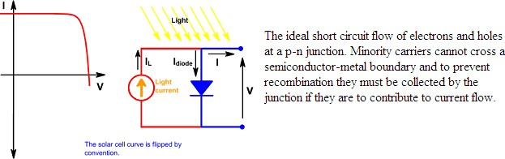
2.2.3 I-V equation of solar cell and solar cell characteristics The IV curve of a solar cell is the superposition of the IV curve of the solar cell diode in the dark with the light- generated current.1 The light has the effect of shifting the IV curve down into the fourth quadrant where power can be extracted from the diode. Illuminating a cell adds to the normal "dark" currents in the diode so that the diode law becomes:
where IL = light generated current.

Slide 12


The effect of light on the current-voltage characteristics of a p-junction. The equation for the IV curve in the first quadrant is:
The -1 term in the above equation can usually be neglected. The exponential term is usually >> 1 except for voltages below 100 mV. Further, at low voltages, the light generated current IL dominates the I0 (...) term so the -1 term is not needed under illumination.
Plotting the above equation gives the IV curve below with the relevant points on the curve labeled and discussed in more detail on the following pages. The power curve has a a maximum denoted as PMP where the solar cell should be operated to give the maximum power output. It is also denoted as PMAX or maximum power point (MPP) and occurs at a voltage of VMP and a current of IMP.

Slide 13
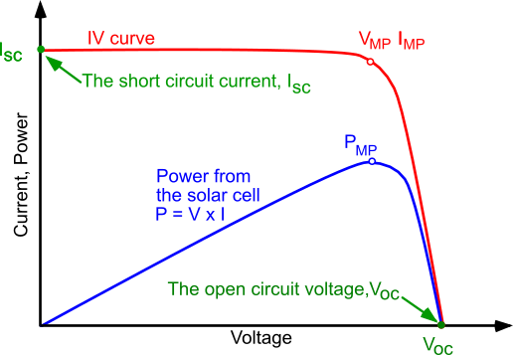
Current voltage (IV) cure of a solar cell. To get the maximum power output of a solar cell it needs to operate at the maximum power point, PMP.

Slide 14

Rearranging the equation above gives the voltage in terms of current:
When I > IL the number in side the ln( ) is negative and undefined. So what happens in reality? The solar cell goes into reverse bias (negative voltage) and either the non-idealities in the solar cell limit the voltage or the supply limits the voltage. In either case, the solar cell will dissipate power. If there is no limit on the supply then a solar cell close to ideal (very high RSHUNT in reverse bias) will be destroyed almost instantly. Other cells will be destroyed due to heating.

Slide 15
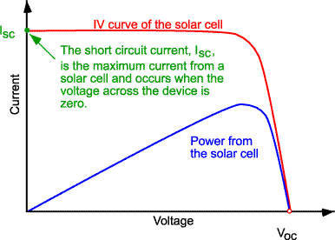
2.3 Upper limits of cell parameters
2.3.1 short circuit current
The short-circuit current is the current through the solar cell when the voltage across the solar cell is zero (i.e., when the solar cell is short circuited). Usually written as ISC, the short-circuit current is shown on the IV curve below.

Slide 16
The short-circuit current depends on a number of factors which are described below:
the area of the solar cell. To remove the dependence of the solar cell area, it is more common to list the short-circuit current density (Jsc in mA/cm²) rather than the short-circuit current;
the number of photons (i.e., the power of the incident light source).
Isc from a solar cell is directly dependant on the light intensity as discussed in Effect of Light Intensity;
the spectrum of the incident light. For most solar cell measurement, the spectrum is standardised to the AM1.5 spectrum;
the optical properties (absorption and reflection) of the solar cell (discussed in Optical Losses); and
the collection probability of the solar cell, which depends chiefly on
the surface passivation and the minority carrier lifetime in the base.

Slide 17
When comparing solar cells of the same material type, the most critical material parameter is the diffusion length and surface passivation. In a cell with perfectly passivated surface and uniform generation, the equation for the short-circuit current can be approximated as:
where G is the generation rate, and Ln and Lp are the electron and hole diffusion lengths respectively. Although this equation makes several assumptions which are not true for the conditions encountered in most solar cells, the above equation nevertheless indicates that the short- circuit current depends strongly on the generation rate and the diffusion length.
Silicon solar cells under an AM1.5 spectrum have a maximum possible
current of 46 mA/cm². Laboratory devices have measured short-circuit currents of over 42 mA/cm², and commercial solar cell have short- circuit currents between about 28 mA/cm² and 35 mA/cm².

Slide 18
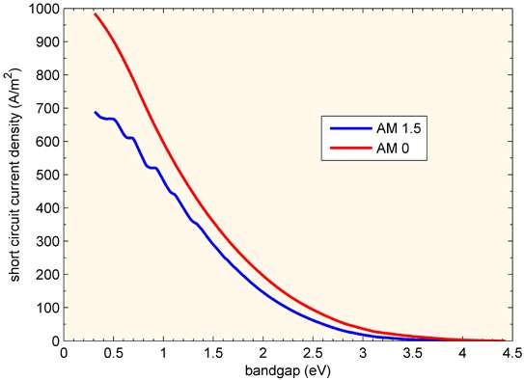
In an ideal device every photon above the bandgap gives one charge carrier in the external circuit so the highest current is for the lowest bandgap.

Slide 19
Illuminated Current and Short Circuit Current (IL or Isc ?)
IL is the light generated current inside the solar cell and is the correct term to use in the solar cell equation. At short circuit conditions the externally measured current is Isc. Since Isc is usually equal to IL, the two are used interchangeably and for simplicity and the solar cell equation is written with Isc in place of IL. In the case of very high series resistance (> 10 Ωcm²) Isc is less than IL and writing the solar cell equation with Isc is incorrect.
Another assumption is that the illumination current IL is solely dependent on the incoming light and is independent of voltage across the cell. However, IL varies with voltage in the case of drift-field solar cells and where carrier lifetime is a function of injection level such as defected multicrystalline materials.

Slide 20
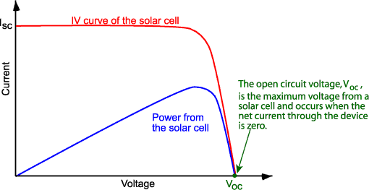
2.3.2 open circuit voltage The open-circuit voltage, VOC, is the maximum voltage available from a solar cell, and this occurs at zero current. The open-circuit voltage corresponds to the amount of forward bias on the solar cell due to the bias of the solar cell junction with the light-generated current. The open-circuit voltage is shown on the IV curve below.

Slide 21

An equation for Voc is found by setting the net current equal to zero in the solar cell equation to give:
A casual inspection of the above equation might indicate that VOC goes up linearly with temperature. However, this is not the case as I0 increases rapidly with temperature primarily due to changes in the intrinsic carrier concentration ni. The effect of temperature is complicated and varies with cell technology. See the page “Effect of Temperature” for more details
VOC decreases with temperature. If temperature changes, I0 also changes.

Slide 22

The above equation shows that Voc depends on the saturation current of the solar cell and the light-generated current. While Isc typically has a small variation, the key effect is the saturation current, since this may vary by orders of magnitude. The saturation current, I0 depends on recombination in the solar cell. Open-circuit voltage is then a measure of the amount of recombination in the device. Silicon solar cells on high quality single crystalline material have open-circuit voltages of up to 764 mV under one sun and AM1.5 conditions, while commercial devices on multicrystalline silicon typically have open- circuit voltages around 600 mV.
The VOC can also be determined from the carrier concentration:
where kT/q is the thermal voltage, NA is the doping concentration, Δn is the excess carrier concentration and ni is the intrinsic carrier concentration. The determination of VOC from the carrier concentration is also termed Implied VOC.

Slide 23


Voc as a Function of Bandgap, EG
Where the short-circuit current (ISC) decreases with increasing bandgap, the open-circuit voltage increases as the band gap increases. In an ideal device the VOC is limited by radiative recombination and the analysis uses the principle of detailed balance to determine the minimum possible value for J0.
The minimum value of the diode saturation current is given by:
where q is the electronic charge, σ is the Stefan–Boltzmann constant, k is Boltzmann constant, T is the temperature and
Evaluating the integral in the above equation is quite complex.

Slide 24
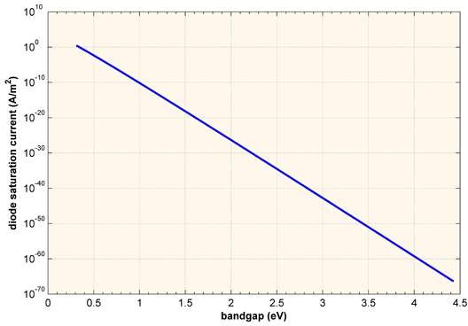
Diode saturation current as a function of band gap. The values are determined from detailed balance and place a limit on the open circuit voltage of a solar cell.

Slide 25
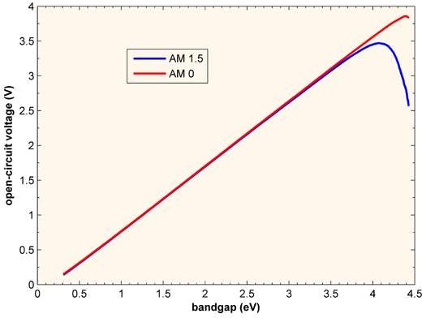
The J0 calculated above can be directly plugged into the standard solar cell equation given at the top of the page to determine the VOC so long as the voltage is less than the band gap, as is the case under one sun illumination.
VOC as function of bandgap for a cell with AM 0 and AM 1.5. The VOC increases with bandgap as the recombination current falls. There is drop off in VOC at very high band gaps due to the very low ISC.

Slide 26


2.3.3 Fill factor The short-circuit current and the open-circuit voltage are the maximum current and voltage respectively from a solar cell. However, at both of these operating points, the power from the solar cell is zero. The "fill factor", more commonly known by its abbreviation "FF", is a parameter which, in conjunction with Voc and Isc, determines the maximum power from a solar cell. The FF is defined as the ratio of the maximum power from the solar cell to the product of Voc and Isc so that:
Graphically, the FF is a measure of the "squareness" of the solar cell and is also the area of the largest rectangle which will fit in the IV curve. The FF is illustrated below.

Slide 27
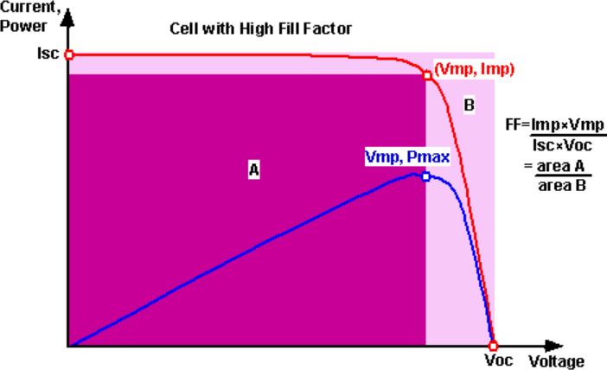
Graph of cell output current (red line) and power (blue line) as a function of voltage. Also shown are the cell short-circuit current (Isc) and open-circuit voltage (VOC) points, as well as the maximum power point (Vmp, Imp). Click on the graph to see how the curve changes for a cell with low FF.

Slide 28
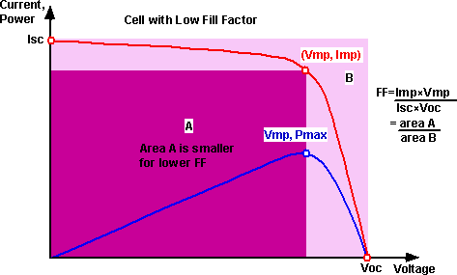
Graph of cell output current (red line) and power (blue line) as a function of voltage. Also shown are the cell short-circuit current (Isc) and open-circuit voltage (VOC) points, as well as the maximum power point (Vmp, Imp). Click on the graph to see how the curve changes for a cell with low FF.

Slide 29




As FF is a measure of the "squareness" of the IV curve, a solar cell with a higher voltage has a larger possible FF since the "rounded" portion of the IV curve takes up less area. The maximum theoretical FF from a solar cell can be determined by differentiating the power from a solar cell with respect to voltage and finding where this is equal to zero. Hence:
giving:
The equation above requires Lambert functions to solve (see below) but a simpler approach is to use iteration to calculate VMP. The equation above only relates Voc to VMP and extra equations are needed to find IMP and FF. A more commonly used expression for the FF can be determined empirically as:
where voc is defined as a "normalized Voc":

Slide 30

The above equations show that a higher voltage will have a higher possible FF. However, large variations in open-circuit voltage within a given material system are relatively uncommon. For example, at one sun, the difference between the maximum open-circuit voltage measured for a silicon laboratory device and a typical commercial solar cell is about 120 mV, giving maximum FF's respectively of 0.85 and 0.83. However, the variation in maximum FF can be significant for solar cells made from different materials. For example, a GaAs solar cell may have a FF approaching 0.89.
A key limitation in the equations described above is that they represent a
maximum possible FF, although in practice the FF will be lower due to the presence of parasitic resistive losses, which are discussed in Effects of Parasitic Resistances. Therefore, the FF is most commonly determined from measurement of the IV curve and is defined as the maximum power divided by the product of Isc*Voc, i.e.:

Slide 31




Exact determination of VMP The equation for a solar cell is:
and in addition the -1 term has no effect at VMP
VMP is when the derivative of the power with respect to V is zero: V> > Vt and rearranging gives:

Slide 32



The Lambert W function provides the solution to a class of exponential functions.
so we get:
using the expression for VOC we can also write:

Slide 33
2.3.4 Efficiency
The efficiency is the most commonly used parameter to compare the performance of one solar cell to another. Efficiency is defined as the ratio of energy output from the solar cell to input energy from the sun. In addition to reflecting the performance of the solar cell itself, the efficiency depends on the spectrum and intensity of the incident sunlight and the temperature of the solar cell. Therefore, conditions under which efficiency is measured must be carefully controlled in order to compare the performance of one device to another. Terrestrial solar cells are measured under AM1.5 conditions and at a temperature of 25°C. Solar cells intended for space use are measured under AM0 conditions..

Slide 34

The efficiency of a solar cell is determined as the fraction of incident power which is converted to electricity and is defined as:
Where:
Voc is the open-circuit voltage;
Isc is the short-circuit current;
FF is the fill factor and
η is the efficiency.
The input power for efficiency calculations is 1 kW/m² or 100 mW/cm². Thus the input power for a 100 × 100 mm² cell is 10 W and for a 156 × 156 mm² cell is 24.3 W

Slide 35
2.4 losses in solar cells
The major losses in solar cells are
Reflection Loss,
Resistive Loss,
Recombination Loss And
Thermal Loss
which affect the efficiency of solar cell adversely.

Slide 36
2.4.1 Reflection Loss
The reflection loss occurs from top surface of the solar cells which receives the light. Reflection losses affect the Isc
short circuit current of the solar cell. Reflection reduces the
absorbed carriers and hence the Isc. It becomes necessary to improve the absorption and reduce reflection to improve short circuit current. For a bare Si these losses account for
more than 30%.
To reduce the reflectivity in solar cells a common approach is, use of an antireflective coating (ARC ≤ 60nm).

Slide 37
2.4.2 Recombination Losses
Photon incident on the solar cell generates electron hole pairs, these generated pairs are called as carriers. Generated carriers needs to be separated before they recombine, with emission of energy. Recombination causes loss of carrier and affects the performance of the cell. Open circuit voltage Voc of the cell is affected by recombination of carriers. As recombination increases the Voc reduces. Various techniques are used to reduce the recombination in the solar cells and improve Voc. Generation of carriers is in the entire volume of the solar cell material. The carriers generated near depletion region are separated out very quickly as they get swept away by the electric field present in the depletion region. Were as the carriers which are generated away from the depletion region that is in the bulk region, on the surface, or at the back surface have less probability of getting separated. These carriers will be lost and would not contribute to the current low if they recombine. Recombination of carriers generated in the Solar cells due to photo excitation is one of the most dominating loss occurring in the solar cell. These losses account for major portion total input power.

Slide 38
Different recombination losses that occur at different regions of the solar cells are
Surface recombination.
Bulk recombination.
Depletion region recombination.
Recombination at metal Semiconductor contact

Slide 39
2.4.2.1 Surface recombination
Surface recombination is high in Si due to the presence of incomplete bonds also called as dangling bonds. These
bonds appear due to sudden disruption of crystal structure.
The incomplete bonds traps the generated carriers and get recombined.
To reduce the effect of surface recombination, passivation
is needed at the surface. This is accomplished by depositing a layer of Si3N4 or SiO2 at the top surface.

Slide 40
2.4.2.2 Depletion region recombination
Recombination occurring in the depletion region is less significant as compared to the surface recombination due to
the presence of electric field. Charge carriers generated in
depletion region are separated by electric field very quickly avoiding any chance of recombination. Any recombination occurring in the depletion region is mostly driven by the
trap assisted recombination or band to band recombination.

Slide 41
2.4.2.3 Bulk recombination
Trap assisted recombination is dominating in the bulk region of the solar cell. As explained earlier the impurities
if present in the semiconductor create a energy state which
acts as the trap. To reduce the trap assisted recombination a high purity semiconductor material is required.

Slide 42
2.4.2.4 Recombination at Metal Semiconductor contacts Metal semiconductor contacts regions provide very large recombination sites. Semiconductor and metal contact junctions are formed at both front and back side of the solar
cell. Back side contact contributes recombination as it has more contact
more area
to the with the
also
semiconductor. Surface recombination velocity is
present at the rear contact and needs to be reduced. Rear surface passivation can reduce this.

Slide 43
2.4.3 Series Resistance Losses
Series resistance losses contribute to around less than 20% of the total input power. But these losses increases tremendously when solar cell is operated at high intensities. Series resistance of the cell is combination of,
Emitter layer resistance
Metal-semiconductor contact (front and back)
Metal bus-bars and fingers
Bulk semiconductor resistance
The possible measures that can help to reduce the series resistance are as follows,
1. High conductivity base (substrate) material oat zone(Fz) , zochralski(Cz).

Slide 44
2. Optimizing the the junction depth for reducing the emitter resistance. Increasing the thickness to reduce the sheet resistance.
Increasing the number of fingers by reducing the width increases the current collection and reduces the metal semiconductor contact resistance.
Electroplated metal contacts to reduce the resistance of the metal contacts by increasing the metal density.
Different etallization techniques Burried contact, H design, Back contact.
Use of different techniques for depositing metal contacts at the front and back surface. This is called as the Hybrid contacts. This can reduce
the cost of deposition of metals.

Slide 45
2.4.4 Thermal Losses
A major portion of loss in solar cell is a due to heat. Light absorbed by the solar cells has excess energy than that required for generation of electron hole pair (band-gap energy Eg). This excess energy is released in the form heat. This thermal energy causes rise of temperature of cell. The parameters that are affected by the temperature of the cell are band gap energy, diffusion length, minority carrier lifetime, intrinsic carrier density. The increases in diffusion length and minority carrier concentration and intrinsic carrier concentration and decrease in band gap energy causes the increases in the reverse saturation current Io. The increase in Io reduces the open circuit voltage which degrades the efficiency of the cell.
If temperature rise is kept within limits with the help of proper cooling
arrangements, with use of heat sinks or heat pipes, thermal losses could be maintained within limits.

Slide 46
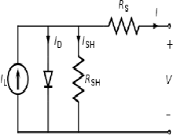

2.5 model of solar cell
To understand the electronic behavior of a solar cell, it is useful to create a model which is electrically equivalent, and is based on discrete ideal electrical components whose behavior is well defined. An ideal solar cell may be modelled by a current source in parallel with a diode; in practice no solar cell is ideal, so a shunt resistance and a series resistance component are added to the model. The resulting equivalent circuit of a solar cell is shown on the left. Also shown, on the right, is the schematic representation of a solar cell for use in circuit diagrams.
The equivalent circuit of a solar cell & schematic symbol of a solar cell

Slide 47
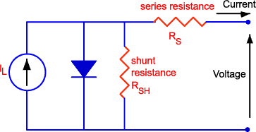
2.6 effect of series –shunt Resistance on efficiency Resistive effects in solar cells reduce the efficiency of the solar cell by dissipating power in the resistances. The most common parasitic resistances are series resistance and shunt resistance. The inclusion of the series and shunt resistance on the solar cell model is shown in the figure below.
Parasitic series and shunt resistances in a solar cell circuit.

Slide 48
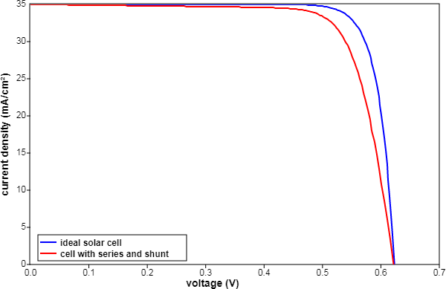
In most cases and for typical values of shunt and series resistance, the key impact of parasitic resistance is to reduce the fill factor. Both the magnitude and impact of series and shunt resistance depend on the geometry of the solar cell, at the operating point of the solar cell.
In the presence of both series and shunt resistances, the IV curve of the solar cell is given by;

Slide 49
2.7 effect solar radiation on efficiency Changing the light intensity incident on a solar cell changes all solar cell parameters, including the short-circuit current, the open-circuit voltage, the FF, the efficiency and the impact of series and shunt resistances. The light intensity on a solar cell is called the number of suns, where 1 sun corresponds to standard illumination at AM1.5, or 1 kW/m². For example a system with 10 kW/m² incident on the solar cell would be operating at 10 suns, or at 10X. A PV module designed to operate under 1 sun conditions is called a "flat plate" module while those using concentrated sunlight are called "concentrators".

Slide 50
Concentrators
A concentrator is a solar cell designed to operate under illumination greater than 1 sun. The incident sunlight is focused or guided by optical elements such that a high intensity light beam shines on a small solar cell. Concentrators have several potential advantages, including a higher efficiency potential than a one-sun solar cell and the possibility of lower cost. The short-circuit current from a solar cell depends linearly on light intensity, such that a device operating under 10 suns would have 10 times the short-circuit current as the same device under one sun operation. However, this effect does not provide an efficiency increase, since the incident power also increases linearly with concentration. Instead, the efficiency benefits arise from the logarithmic dependence of the open-circuit voltage on short circuit. Therefore, under concentration, Voc increases logarithmically with light intensity, as shown in the equation below;

Slide 51
where X is the concentration of sunlight.
From the equation above, a doubling of the light intensity (X=2) causes a 18 mV rise in VOC .
The cost of a concentrating PV system may be lower than a corresponding flat- plate PV system since only a small area of solar cells is needed.
The efficiency benefits of concentration may be reduced by increased losses in series resistance as the short-circuit current increases and also by the increased temperature operation of the solar cell. As losses due to short-circuit
current depend on the square of the current, power loss due to series resistance increases as the square of the concentration.

Slide 52
Low Light Intensity
Solar cells experience daily variations in light intensity, with the incident power from the sun varying between 0 and 1 kW/m². At low light levels, the effect of the shunt resistance becomes increasingly important. As the light intensity decreases, the bias point and current through the solar cell also decreases, and the equivalent resistance of the solar cell may begin to approach the shunt resistance. When these two resistances are similar, the fraction of the total current flowing through the shunt resistance increases, thereby increasing the fractional power loss due to shunt resistance. Consequently, under cloudy conditions, a solar cell with a high shunt resistance retains a greater fraction of its original power than a solar cell with a low shunt resistance.

Slide 53
2.7 effect of temperature on efficiency
Like all other semiconductor devices, solar cells are sensitive to temperature. Increases in temperature reduce the band gap of a semiconductor, thereby effecting most of the semiconductor material parameters. The decrease in the band gap of a semiconductor with increasing temperature can be viewed as increasing the energy of the electrons in the material. Lower energy is therefore needed to break the bond. In the bond model of a semiconductor band gap, reduction in the bond energy also reduces the band gap. Therefore increasing the temperature reduces the band gap.
In a solar cell, the parameter most affected by an increase in
temperature is the open-circuit voltage. The impact of increasing temperature is shown in the figure below.

Slide 54
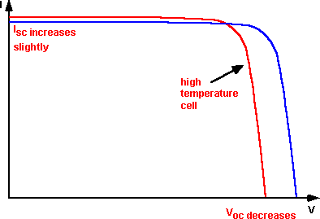
The open-circuit voltage decreases with temperature because of the temperature dependence of I0.

Slide 55
2.8 basic design aspects of solar cells.
Solar cell design involves specifying the parameters of a solar cell structure in order to maximize efficiency, given a certain set of constraints. These constraints will be defined by the working environment in which solar cells are produced. For example in a commercial environment where the objective is to produce a competitively priced solar cell, the cost of fabricating a particular solar cell structure must be taken into consideration. However, in a research environment where the objective is to produce a highly efficient laboratory-type cell, maximizing efficiency rather than cost, is the main consideration.

Slide 56
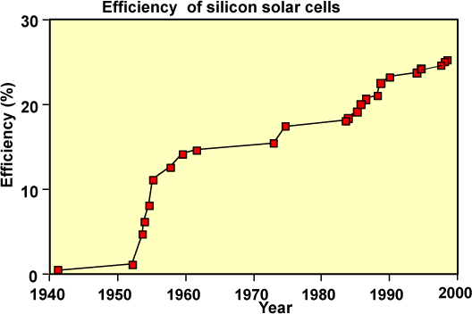
Evolution of silicon solar cell efficiency.

Slide 57
The theoretical efficiency for photovoltaic conversion is in excess of 86.8%. However, the 86.8% figure uses detailed balance calculations and does not describe device implementation. For silicon solar cells, a more realistic efficiency under one sun operation is about 29% . The maximum efficiency measured for a silicon solar cell is currently 24.7% under AM1.5G. The difference between the high theoretical efficiencies and the efficiencies measured from terrestrial solar cells is due mainly to two factors. The first is that the theoretical maximum efficiency predictions assume that energy from each photon is optimally used, that there are no unabsorbed photons and that each photon is absorbed in a material which has a band gap equal to the photon energy. This is achieved in theory by modeling an infinite stack of solar cells of different band gap materials, each absorbing only the photons which correspond exactly to its band gap.

Slide 58
The second factor is that the high theoretical efficiency predictions assume a high concentration ratio. Assuming that temperature and resistive effects do not dominate in a concentrator solar cell, increasing the light intensity proportionally increases the short- circuit current. Since the open-circuit voltage (Voc) also depends on the short-circuit current, Voc increases logarithmically with light level. Furthermore, since the maximum fill factor (FF) increases with Voc, the maximum possible FF also increases with concentration. The extra Voc and FF increases with concentration which allows concentrators to achieve higher efficiencies.
In designing such single junction solar cells, the principles for maximizing cell efficiency are:
increasing the amount of light collected by the cell that is turned into carriers;
increasing the collection of light-generated carriers by the p-n junction;
minimising the forward bias dark current;
extracting the current from the cell without resistive losses.

